Slide 1



SHRI SANT GAJANAN MAHARAJ COLLEGE OF ENGINEERING SHEGAON
Department of Information Technology
2021-2022
Project Title:- Document Analyzer
Group Number:- 13
Group Members:-
Ayush Batra (40)
Ayush Naphade (39)
Kiran Kolte (47)
Neha Lokhande (13)
Project Guide:
Prof. S. S. Muddalkar

Slide 2
AGENDA
Title of the Project
Problem Definition
Objective
Technology Stack
Requirements
Work Flow
Potential Use/Users
Outcomes

Slide 3
PROBLEM DEFINITION
Today many companies or individual manually extract data from document (scanned/hardcopy) like forms, PDF’s and images or through simple OCR software that requires manual configuration which often times requires reconfiguration when the form changes.
To overcome this manual and expensive process and reduce the chance of error we are creating a software that can analyze document, extract information, important figures and store that data in the format according to user choice.
Further user can easily manipulate and edit that data

Slide 4
OBJECTIVE
Redefining document analysis.
To reduce the level of human intervention necessary in extracting data from document .
To reduce the margin of error while document analysis.
To overcome the manual and expensive method of document analysis and data extraction process.

Slide 5
TECHNOLOGY STACKS
Amazon Web Services
Lambda
Textract
ECR
API Gateway
Docker
Python
AWS SDK
C# (Windows Form)

Slide 6
REQUIREMENTS
PyCharm IDE
Visual Studio 2019
AWS Account
Windows form framework
Docker
Postman

Slide 7
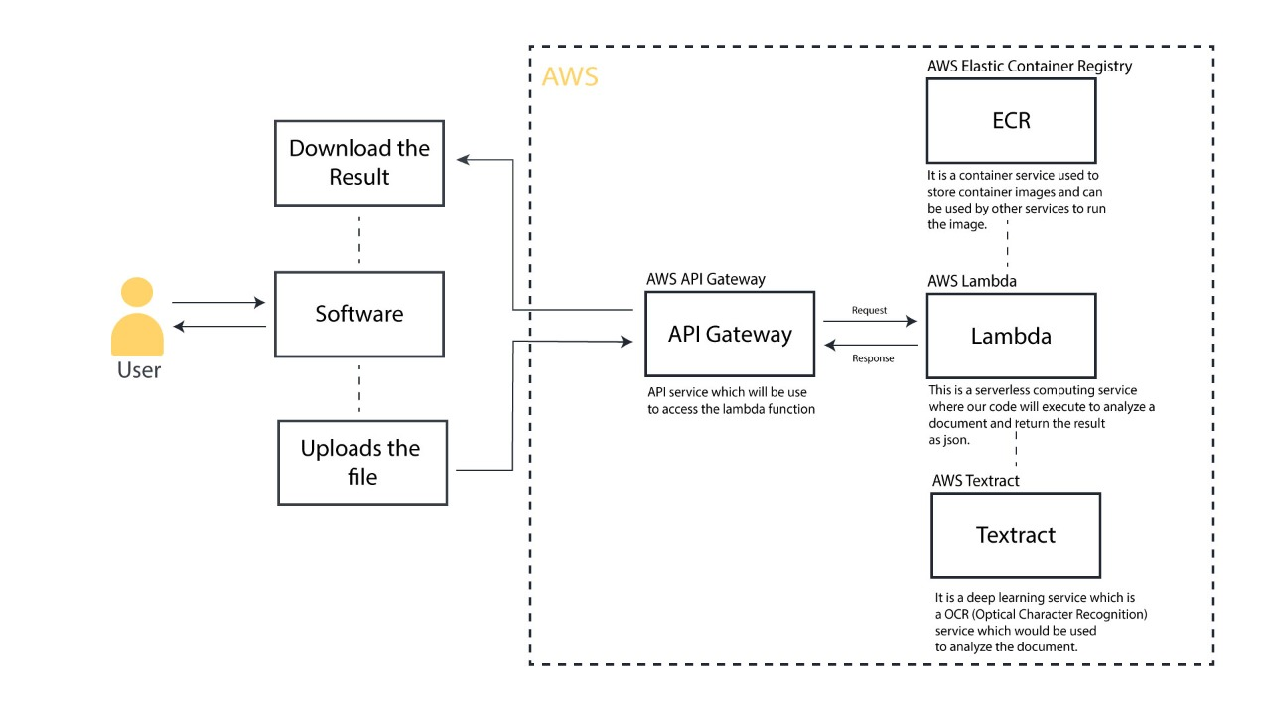
WORKFLOW

Slide 8
PROJECT PLAN
Phase 1
Research (Literature survey)
Analysis
Phase 2
Planning
Designing (UI development)
Phase 3
Frontend development
Backend development

Slide 9
Phase 4
Testing
Documentation

Slide 10
POTENTIAL USER
Accounting and Financing: The extracted data can be useful in accounting and financing for paying bills and audit work.
It can be generally used to add and update records in various sectors like healthcare, insurance, and education sector.

Slide 11
OUTCOMES
Research Paper Published in Journal:
Paper Name: Use of OCR technology for Data Extraction Using Amazon Textract.
Publication Name: International Journal of Advanced Research in Science, Communication and Technology.
Issue Number: Volume 2, Issue 3, April 22
ISSN NO: 2581-9429

Slide 12
OUTCOMES
Participation in Project Competition:
Competition Name: Sodh 2022
Organized By: SNJB’s LS KBJ College of Engineering, Chandwad, Nashik
Certificate_ID :99

Slide 13
THANK YOU!
Close

